Slide 1

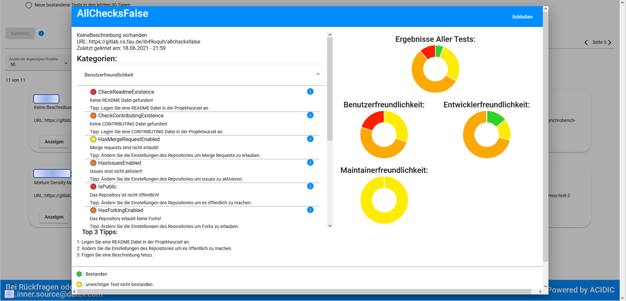
Inner Source Linter an AMOS project in collaboration with DATEV
We help inner-source initiatives improve their projects and raise awareness of great projects.

